Slide 1
Analyzing Market Dynamics and Revitalizing Brand Strategy
BIA 810
Health Care Data & Analytics
Final Project
[Team 2]

Slide 2








Meet the Team!
Dharani
Ishaan
Rishika
Professor: Sanjiv Koshal
Rohini
SaiKiran
Sanjeet

Slide 3
Agenda
Executive Summary
Market Landscape
Key Drivers
Strategic Roadmap
Future Outlook

Slide 4
PROBLEM STATEMENT:
The company operates a market-leading anesthetic (Ketorolac) and has launched a variant (Midazolam) intended to internally cannibalize the declining legacy brand. By design, Midazolam was expected to absorb Ketorolac’s volume decline, thereby preserving overall franchise share.
However, claims evidence indicates that this intended cannibalization has not materialized. While Ketorolac continues to decline, Midazolam has failed to capture this volume, allowing the main competitor (Fentanyl) to gain share instead. As a result, the franchise is experiencing net market share erosion, driven by ineffective internal substitution rather than external market contraction.
BUSINESS SOLUTION
We propose a post-trial conversion–focused commercial strategy for Midazolam that shifts emphasis from new-writer acquisition to repeat usage, protocol anchoring, and targeted territory execution, leveraging insights from high-performing territories and salvageable prescribers.
Executive Summary

Slide 5
BUSINESS IMPACT
Arrest “One-and-done” prescribing behavior for Midazolam
Enhance conversion of Midazolam from first prescription to repeat and habitual use
Increase Effectiveness of sales force execution in declining territories
Reduce Leakage of Midazolam triers to the main competitor (Product 3)
Support key Sales & Marketing initiatives by
Re-aligning KPIs from new writer count to repeat writer conversion
Enabling targeted follow-up after first Midazolam prescription
Deploying differentiated messaging centered on replacement and protocol fit, not trial
Executive Summary

Slide 6

Market Basket
 | Product | HCPCS Code | Role in Market
Company Products | Product 1 – Ketorolac | J1885 | Market Leader (or Declining)
Company Products | Product 2 – Midazolam | J2250 | Variant Brand (Target)
Competition | Product 3 – Fentanyl | J3010 | Main Competitor (Growing)
Competition | Product 4 – Propofol | J2704 | Alternative Competitor

Slide 7
Anesthesia Drug Market
Protocol-driven, not preference-driven
Anesthetic choice is governed by established clinical protocols, anesthesia workflows, and institutional norms rather than individual physician experimentation.
Brands that gain share typically do so by anchoring themselves into standard-of-care pathways, not by out-promoting competitors.
High switching cost after adoption
Once an anesthetic is embedded into perioperative protocols, switching requires workflow changes, retraining, and risk reassessment—making post-trial conversion significantly harder than initial trial.

Slide 8
Anesthesia Drug Market
Depth of use matters more than breadth
Market leaders win by achieving repeat, habitual use across procedures, not by maximizing the number of one-time trials.
In absence of a clear replacement narrative, HCPs default back to the incumbent product even after trying a newer variant.
Trial does not equal adoption
Initial usage often reflects availability or sampling, but sustained use reflects confidence in efficacy, safety, and operational fit.
Territory-level execution drives outcomes: Variation in adoption across territories is driven by differences in sales execution, follow-up discipline, and local clinical culture—rather than product differences.

Slide 9
In anesthesiology, behavior changes only after confidence is established
Product | Average Years of usage
Ketorolac (old product) | 2.97
Midazolam (new variant) | 1.83
Fentanyl | 2.48
Propofol | 1.44

Slide 10
Steps taken for data cleaning
Initial Data Quality Assessment:
Missing Records
Duplicate Records
Date & Time Standardization
Identifier & Structural Consistency
Standardized key identifiers (Provider NPI, Patient ID)
Normalized ZIP codes for reliable joins and aggregation
Categorical Data Harmonization
Cleaned and standardized categorical fields (for example: gender)
Eliminated formatting inconsistencies
Completeness to establish baseline data quality and identify issues early
Audited dataset structure, data types

Slide 11
Dataset
1 Mm claim records
~28K line level claims, ~4000 patients
499 doctors, 496 Zip codes
Dataset being analyzed
Data Sources
Medicare CCLF Claims (2016–2018) ~1M raw line-level claims consolidated into 28,368 market-relevant claims
HCP Demographics (NPI, specialty, geography)
Patient Demographics (age, gender)
Diagnosis Code Mapping (ICD-10) → disease specialty
ZIP → Territory Mapping → commercial geography

Slide 12
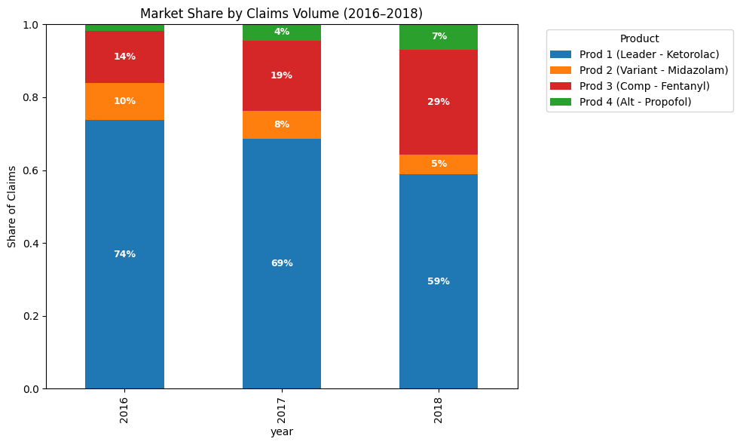
Market leadership remains intact, but competitive forces are actively reshaping prescribing behaviour
Ketorolac remains widely used, but its market share declined from 74% in 2016 to 59% in 2018, while the primary competitor increased its share from 14% to 29%.
The variant product is tried by doctors but not consistently continued and also selective use of alternatives is gradually increasing.
The overall trend reflects doctors switching products rather than a drop in demand.

Slide 13
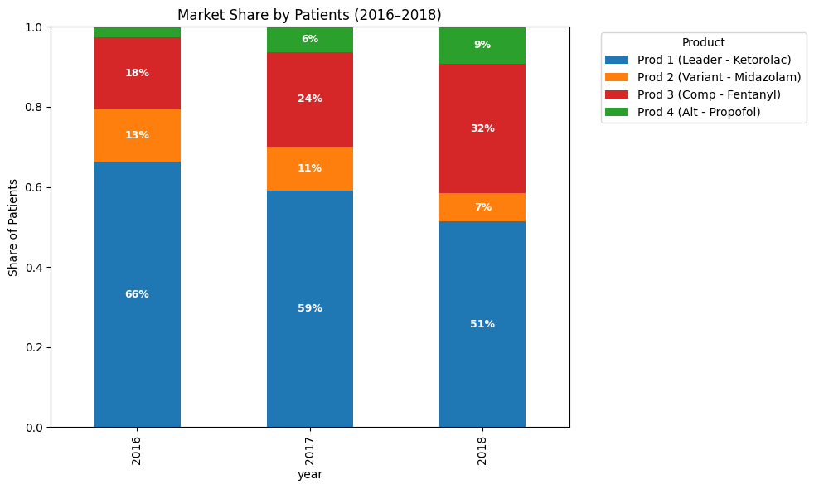
Patient reach remains concentrated, but competitive expansion is accelerating
Ketorolac remains the leading product, but its patient share steadily declined from 66% in 2016 to 51% in 2018, showing a consistent loss in patient reach over time.
The primary competitor gained significant patient adoption, increasing from 18% to 32%, while the variant product declined from 13% to 7%, indicating stronger preference for the main competitor.

Slide 14
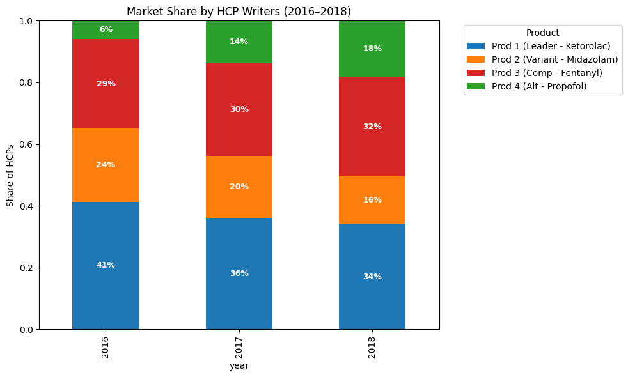
Competitive encroachment is progressively reshaping the prescriber landscape
Ketorolac is still prescribed by the most doctors, but its HCP share declined from 41% in 2016 to 34% in 2018, meaning fewer doctors rely on it exclusively.
Competing products expanded their prescriber base, with the primary competitor increasing from 29% to 32% of HCP writers, while the variant product declined from 24% to 16%.

Slide 15
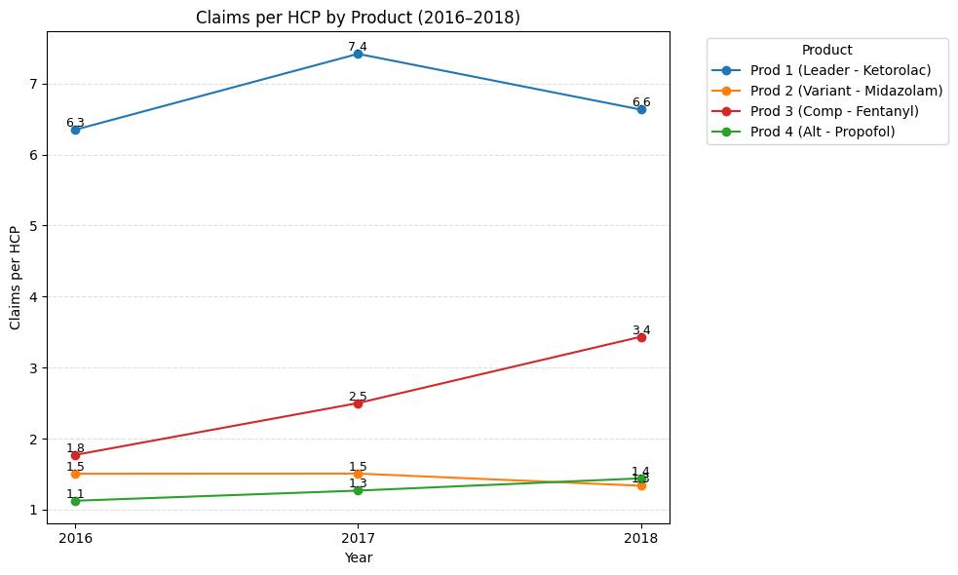
Prescribing intensity is shifting as competitive products gain traction
Ketorolac is still used most per doctor, but growth has flattened, moving from 6.3 claims per HCP in 2016 to 7.4 in 2017 and then dropping to 6.6 in 2018.
The main competitor shows steadily deeper use, with claims per HCP rising from 1.8 to 2.5 to 3.4, indicating stronger repeat prescribing by existing doctors.
Overall, prescribing depth is shifting across products, meaning doctors are switching across products rather than increasing total prescribing volume.

Slide 16
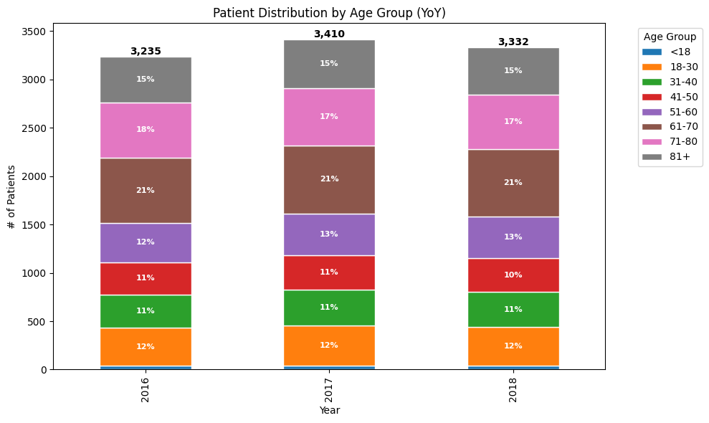
We do not see any major shifts in the patient population

Slide 17
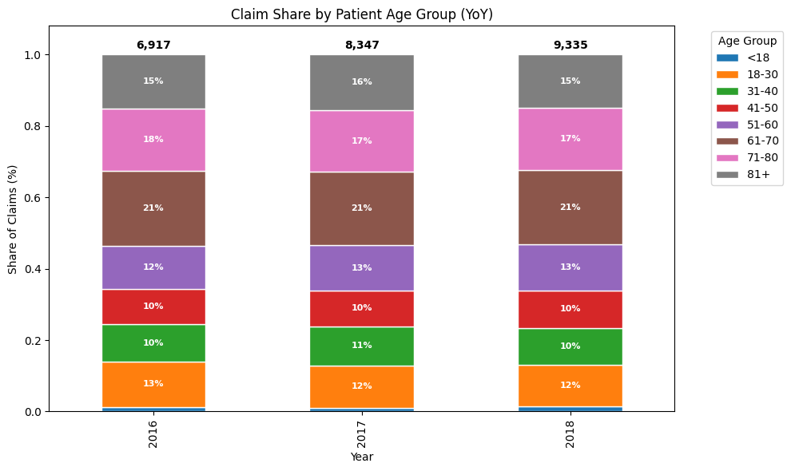
Claim share by patient age seems consistent across years

Slide 18
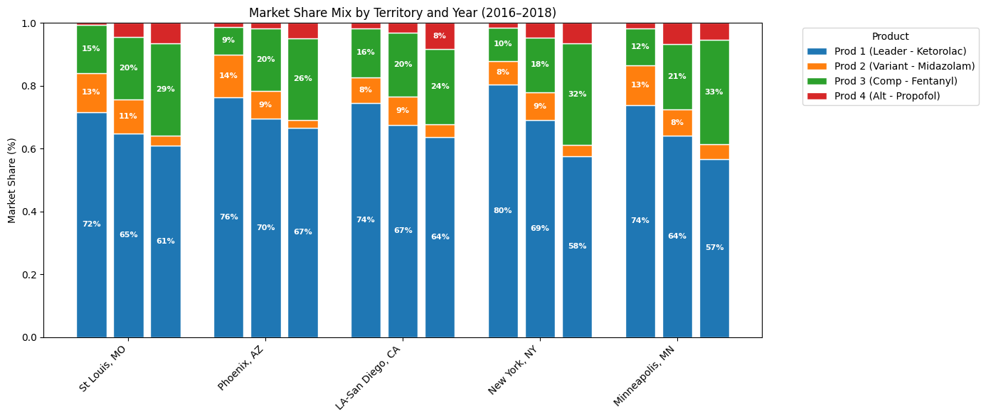
Top 5 market share erosion territories

Slide 19
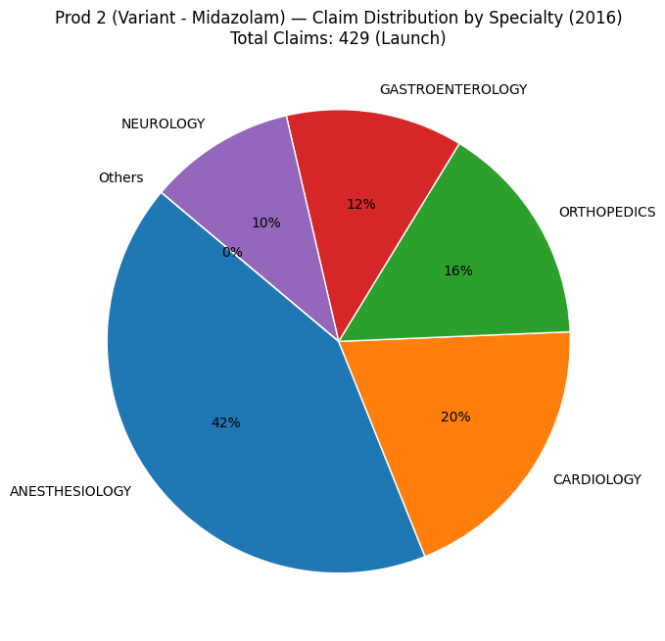
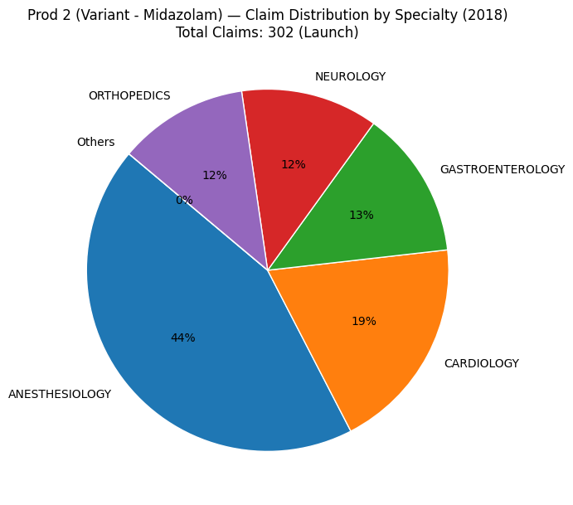
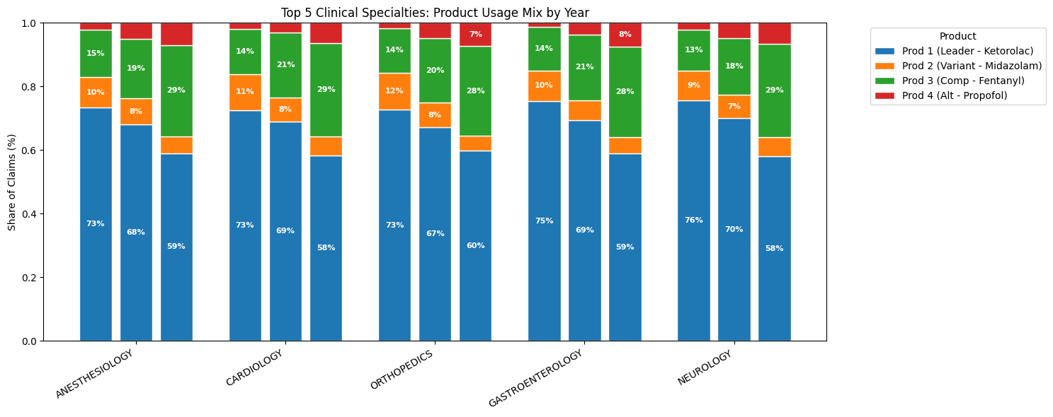
Usage by specialty - Midazolam

Slide 20
Usage by specialty

Slide 21
Usage by specialty – top 5 market share losing territories

Slide 22
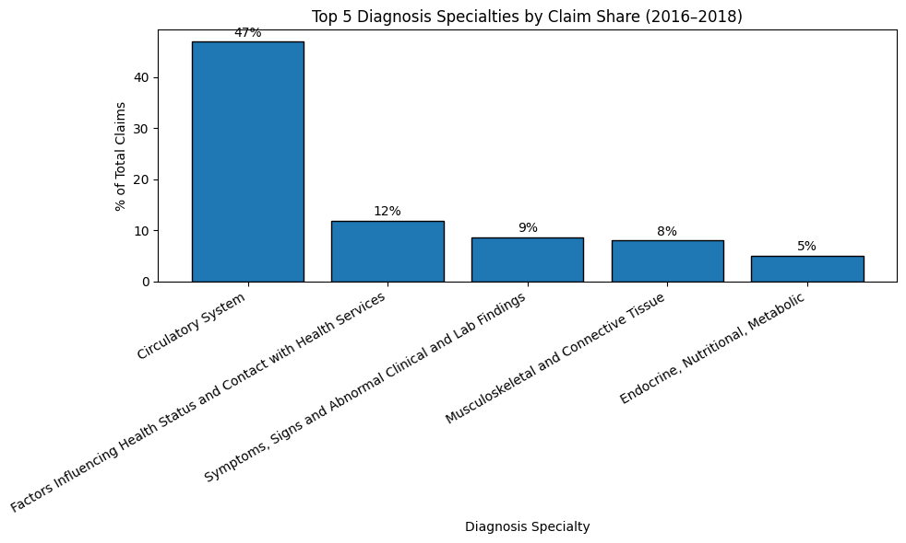
Circulatory system ICD procedures see highest usage of anesthesia products over the years

Slide 23
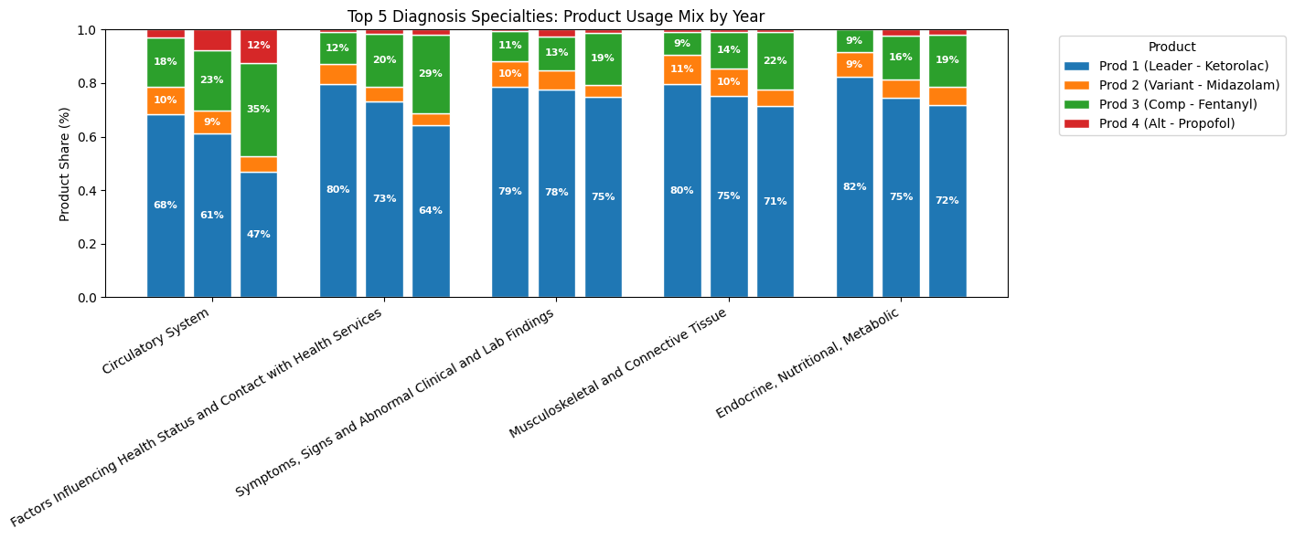
There is high erosion of market share to fentanyl and propofol across ICD codes

Slide 24
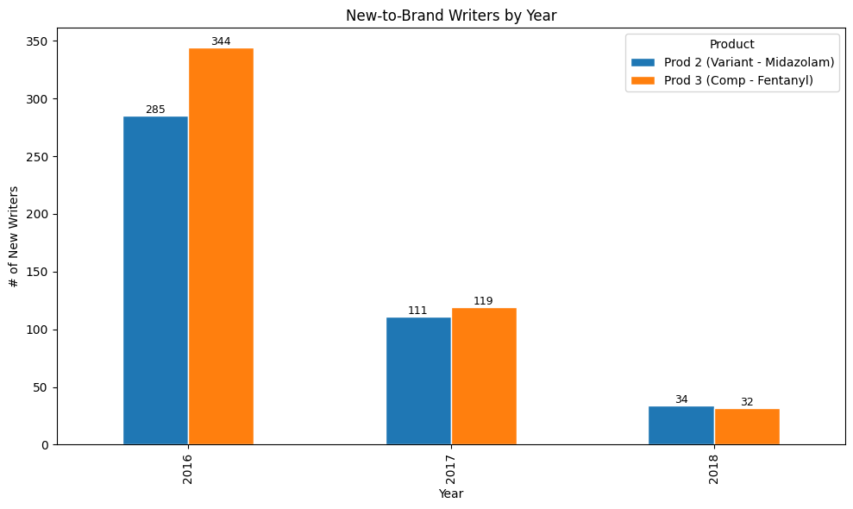
We see almost similar new to brand rx by hcps for both midazolam and fentanyl

Slide 25
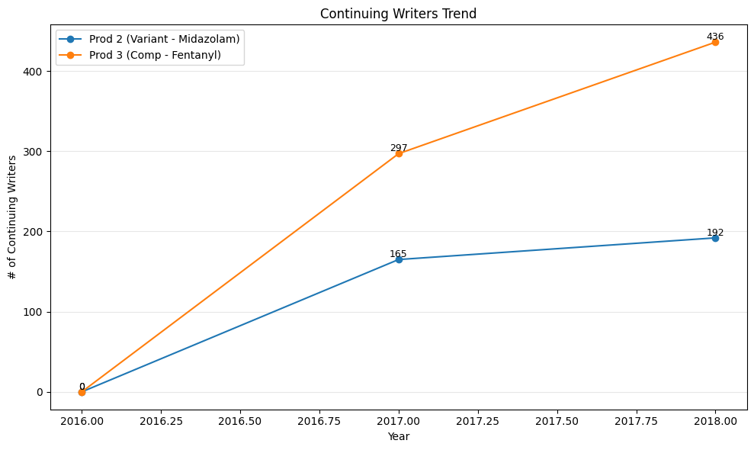
… however, we see that continuing writers of Fentanyl are higher
Product 2 continues to generate new-to-brand writers, but fails to retain them as continuing prescribers. In contrast, Product 3’s growth is driven by stronger writer retention rather than acquisition

Slide 26
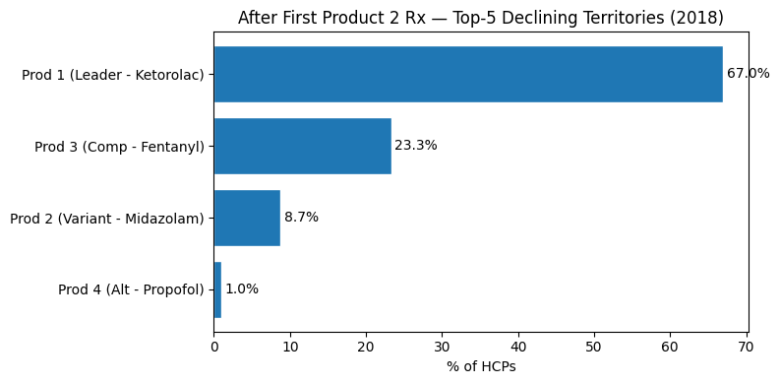
Product 2 is losing not because of awareness, but because of post-trial abandonment:

Slide 27
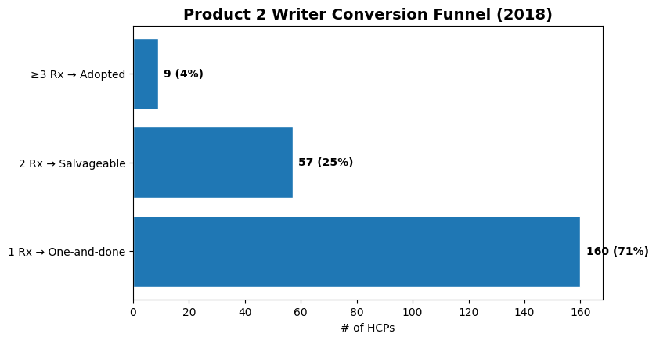
..however, we believe with the right interventions, this can be salvaged
1 claim → “one-and-done” (trial failure)
2 claims → partial conversion, still
recoverable / Salvageable
≥3 claims → already adopted
In 2018, ~25% of Product 2 writers are salvageable — representing the highest-ROI conversion opportunity.

Slide 28
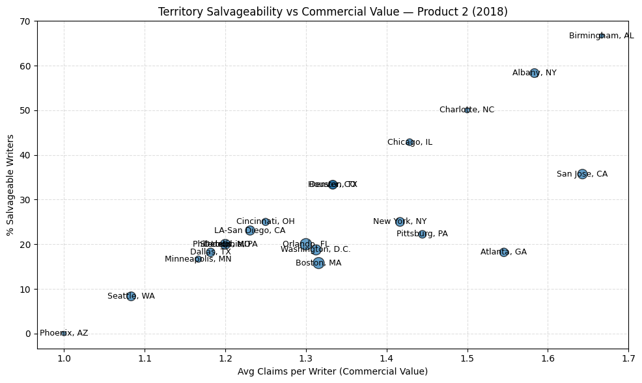
Territory execution diagnostic (2018)

Slide 29

Recommendations
Recognize that trial ≠ adoption - Current performance indicates Product 2 is being sampled but not integrated into routine practice; commercial success must be redefined around sustained prescribing, not first use.
Shift sales KPIs from acquisition to conversion - Move primary field metrics from “new writers” to repeat writers, explicitly tracking 2nd prescription within 45 days and 3rd prescription within 90 days.
Enforce structured post-trial follow-up - Mandate rep follow-up for every new Product 2 writer, supported by CRM alerts flagging “one-and-done” prescribers for immediate intervention.
Reallocate effort toward high-value, salvageable segments - Prioritize high-volume, salvageable writers and focus execution in the most commercially attractive yet declining territories where recovery impact is highest.
Evolve messaging from trial to protocol replacement - Evaluate whether current promotion over-indexes on “Try Product 2” and pivot toward positioning Product 2 as a replacement anesthetic in clearly defined use cases, aligning with real-world prescribing decisions.

Slide 30

Data exploration opportunities & limitations
Promotion Response & Sales Force Effectiveness (Calls Data) – understand whether low conversion is due to insufficient follow-up, ineffective messaging, or misallocated sales effort.
Payer reimbursements - claims data does not show coverage restrictions, or copay burden.
HCP-Level Switching & Protocol Barriers – clinical hindrances to switch
Patient Flow & Therapy Depth (DDD)
Channel Dynamics & Site-of-Care Behavior - Claims do not reveal whether prescribing decisions differ by site of care (hospital, ASC, outpatient)
Notes:
While claims data identifies where Product 2 is failing, additional promotional, access, and channel-level datasets are required to explain why. Integrating these data sources would enable targeted interventions that directly address post-trial conversion failure — the primary driver of Product 2’s market erosion identified in this analysis

Slide 31
Thank you!

